Slide 1

REPORTABLE INCIDENT REPORT
Delphi TVS Technologies Ltd,
Oragadam

Slide 2
INCIDENT DETAILS
Department : Filter Cell
Process / Activity : Pleating machine -1
Injured person : T Monish
CC.No : TIT 1504
Date & Shift : 29.07.2025 & 2nd shift
Incident Time : 10.35 PM

Slide 3
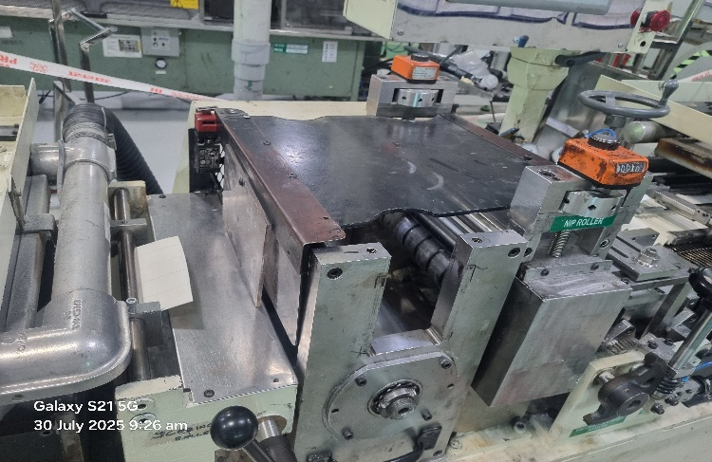
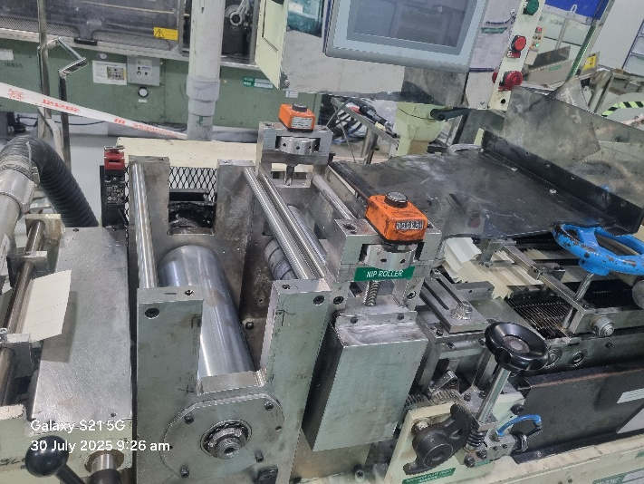
INCIDENT DESCRIPTION
The running Pleating paper roll emptied
Trainee loaded new pleating paper roll at the loading point & started feeding to pleating machine
He found paper struck up (Pop up) inside the roller & removed the paper manually
Then stopped the pleating roller unit and opened the safety door which was in bye passed condition.
Trainee tried to insert the paper roll at the pleating roller station manually by switching on the unit simultaneously.
During the course of this activity, his left hand caught between the pleating rollers and got crush injury in his left index, middle and ring fingers.
He pressed the emergency button immediately. Upon hearing his noise, the line supervisor and maintenance engineer rushed to the spot and removed the roller manually to free his hand .
Safety door
Pleating rollers

Slide 4
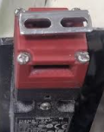
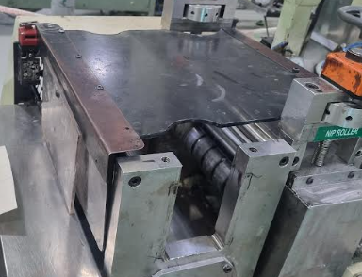
INCIDENT DESCRIPTION
Observations:
1) Pleating Roller safety door switch was found in bye passed condition
2) The machine was operated in an unsafe condition; production continued despite the known failure of the safety system by all responsible personnel
3) Manual insertion of paper while machine was energized
Safety door switch
Safety door switch is not connected with safety door
Safety Door

Slide 5
ROOT CAUSE ANALYSIS
Injury
Crush injury to the left hand index,middle and ring fingers
The trainee’s left hand got caught between the pleating rollers
WHY 1
WHY 2
The operator opened the safety door and inserted his left hand into the running roller. The safety door switch was in a bypassed condition
He attempted to feed the paper manually into the roller gap using his left hand while simultaneously switching on the roller unit with his right hand
WHY 3
WHY 4
The new paper roll did not move properly inside the roller unit
The edges of the running and new paper rolls were not properly joined
WHY 5

Slide 6
CORRECTIVE ACTION
Sl.No | Cause of Accident | Corrective Action | Resp | Status
1 | The safety door switch was in a bypassed condition | Install tamper-proof safety interlock switches with bypass detection alarms | Ravikumar | Completed
 |  | Conduct On the Job training to all trainees/freshers and supervisors (with a focus on LOTO and interlocks) | Thiyagarajan | Completed
 |  | Safety FLM gaps to be reviewed by the Supervisors and Managers | Thiyagarajan | Completed
 |  | Review and audit all machines to identify any other bypassed safety systems | Thiyagarajan/Ravikumar | Completed
2 | The edges of the running and new paper rolls were not properly joined | Develop and implement SOP for paper roll changeover, including safe methods for feeding | Thiyagarajan | Completed

Slide 7
Medical Treatment
First Aid given at Jaya Hospital, Mathur
After First Aid ,Injured person transferred to SIMS Hospital, Vadapalani & admitted under Dr.Karthikeyan-HOD, Plastic Surgeon
Wound debridement & skin grafting is done in SIMS Hospital, Vadapalani

Slide 8

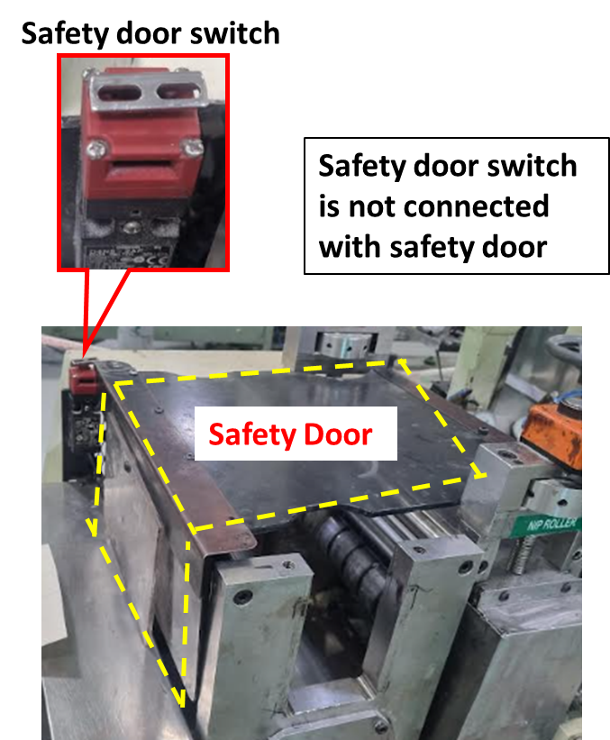
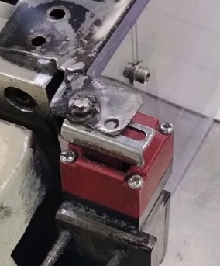
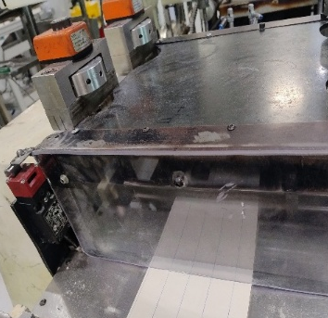
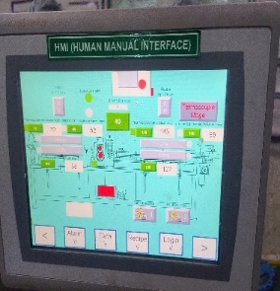
Cause of Accident | Corrective Action
Safety door switch was in a bypassed condition | Installed tamper proof safety interlock switches with bypass detection alarms
Tamper proof interlocking switch provided
Bypass Detection alarms

Slide 9
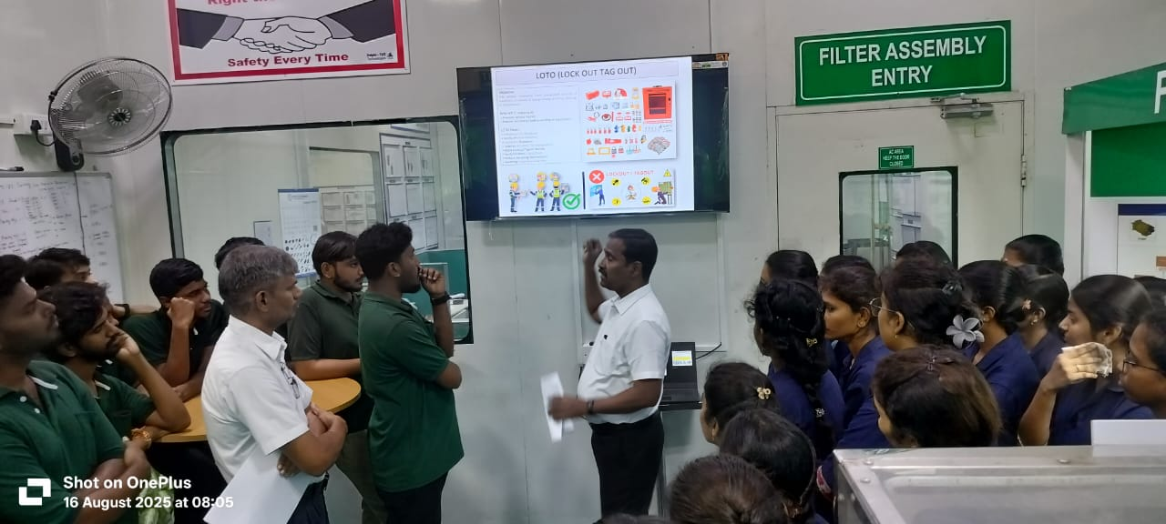
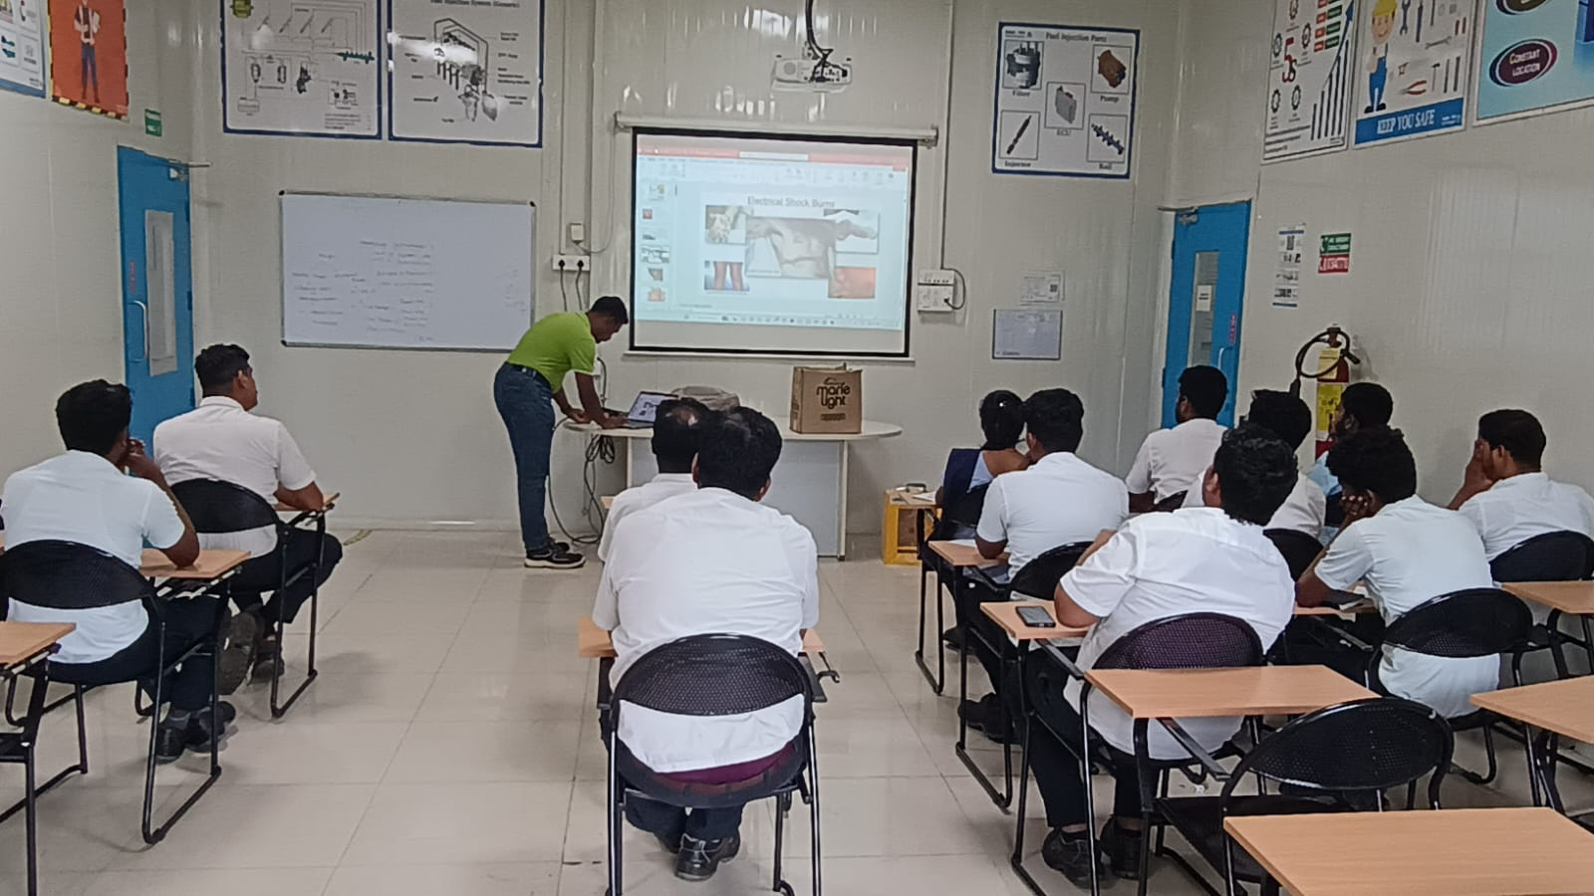
Corrective Action
Conducted on the Job training to all trainees / fresher and supervisors (with a focus on LOTO and interlocks)

Slide 10
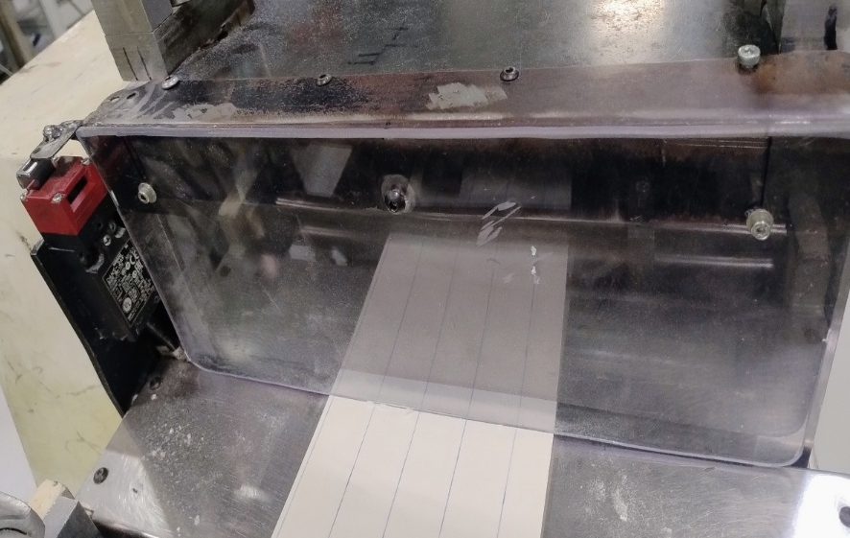
Cause of Accident | Corrective Action
Filter paper entry to roller: Safety door bottom having gap 20mm which having chance of finger may enter inside it | safety door design has been modified to reduce the gap to less than 8 mm

